Slide 1
Docker, Docker Swarm, and much more
Confidential: Internal use only

Slide 2
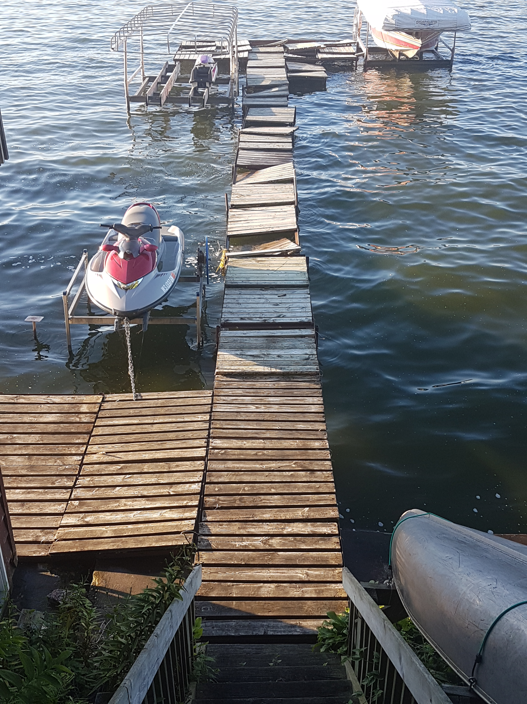
Not the best docker!

Slide 3
Docker Terms
Registry (hub.docker.com, quay.io, gcr.io, ecr) A collection of container image repositories
Repository A collection of container images named repository:tag
Image A committed container
Container A running image

Slide 4
Docker Demos
Docker Architecture
Build Image Manually
Build Image Dockerfile
Docker for Desktop
https://git.ittools.cfahome.com/core/tech-talk-docker

Slide 5
Docker Swarm Demos
Network and Services
Inter Service Communication
Port Publishing and Mesh Routing
Secrets

Slide 6
And more…
Kubernetes (k8s)

